Slide 1

Cloud-Native Solution for Healthcare Data Interoperability
Nikhil Attili • Cotiviti Summer Internship Demo

Slide 2
Overview
Automation of the extraction and processing of text from clinical notes using a suite of cloud-native technologies
It's a sophisticated system that leverages the power of Google Cloud Platform (GCP) to handle healthcare data more efficiently and securely.

Slide 3
Dataflow Pipeline Template
This script creates a pipeline template for processing image paths and sending these images to a cloud function for OCR text extraction.
It exemplifies the use of ETL processes in cloud environments, demonstrating how cloud computing can streamline and automate data handling in healthcare.

Slide 4
Dataflow Pipeline Runner
Responsible for executing the dataflow job, this component illustrates the ease of automating complex data processing tasks in the cloud.
It represents a significant advancement in handling large volumes of healthcare data, ensuring efficient and timely processing.

Slide 5
Cloud Function for Dataflow Template Runner
Hosted as a Google Cloud Function, this script triggers the Dataflow pipeline, showcasing the seamless integration and scalability of cloud services.
This function highlights the flexibility and adaptability of cloud-native architectures in responding to diverse data processing needs.

Slide 6
OCR Text Extractor Cloud Function
This Cloud Function extracts text from images using the OCR.space API, demonstrating the project's capability to handle unstructured data efficiently.
It underlines the potential of cloud-based OCR solutions in transforming the management of clinical documentation.

Slide 7
Architecture

Slide 8
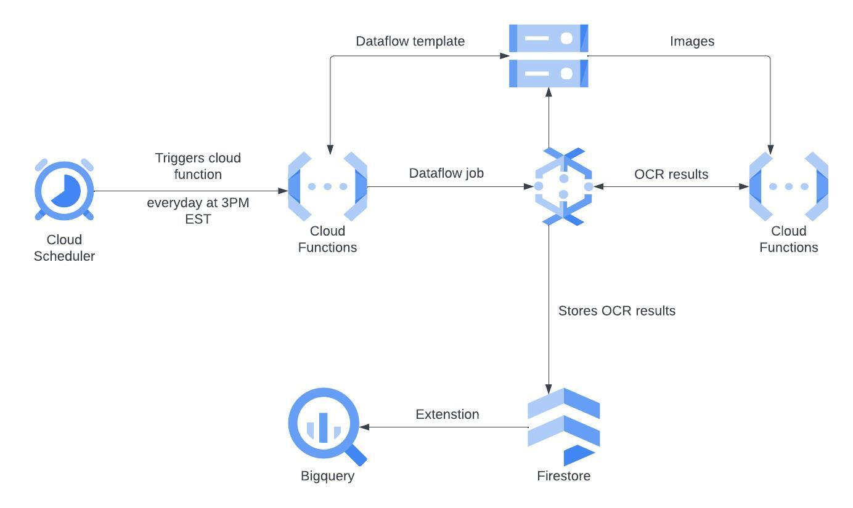

Slide 9
Project Impact
This project significantly enhances data interoperability in healthcare by providing a faster, more secure, and efficient way to process and analyze medical documents.
The use of cloud-native architectures ensures scalability, high availability, and robust security features, marking a leap forward in healthcare data management and accessibility.

Slide 10
Thank you!

